Slide 1
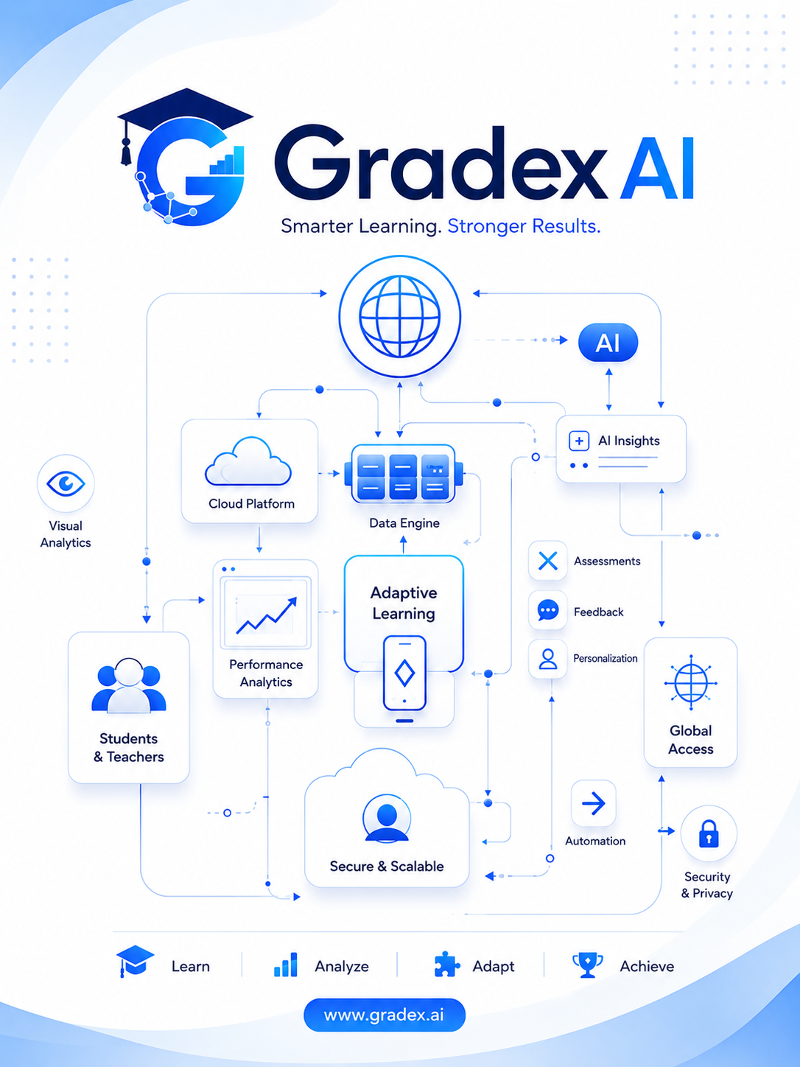
AI-Integrated Multi-Modal Academic Evaluation, Performance Intelligence, and Automated Viva Assessment System

Slide 2

Our Team
Member 01
Member 02
[A.M.Senarathna / IT22262554]
[L.S.B Hemarathne / IT22134776]
Member 03
Member 04
[Herath B.K.H.M.B.L / IT22557056]
[Wickramarathne H.I.B / IT22239198]

Slide 3
What is Gradex AI?
What
Evaluates
AI-assisted academic assessment across multiple modalities
Written Exams • Viva • Diagrams • Analytics
Why
Vision
Manual • Subjective • Slow • Limited insights
Faster, consistent, context-aware assessment for every student

Slide 4

The Assessment Challenge
Grading Overload
High workload for educators and significantly delayed feedback for students
Viva Inconsistency
Examiner variation and subjective judgment produce unequal outcomes
Diagram Complexity
Complex visual structures are difficult to evaluate objectively at scale
Shallow Analytics
Raw marks alone do not reveal learning gaps or conceptual weaknesses
The Need: Automated + Consistent + Multi-Modal + Data-Driven assessment

Slide 5
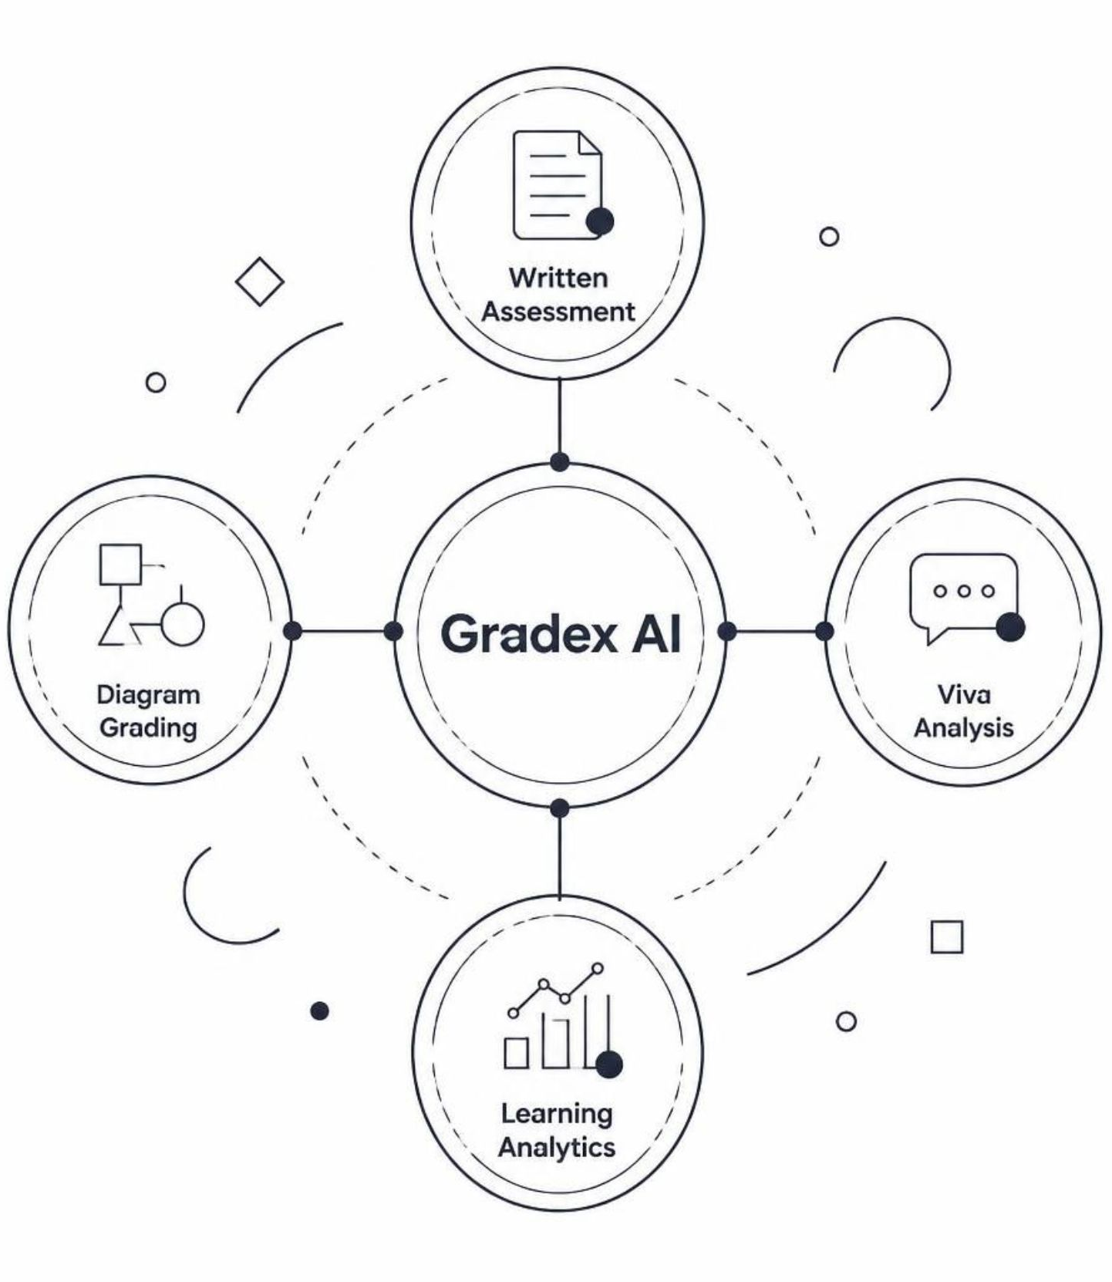
Research Gap
Single Modality
Written or Viva or Diagram in isolation → Unified approach needed
Generic LLM
Answer → Score without context → RAG + Course Context required
Viva Judgment
Pure observation → Video + Audio + Speech analysis
Limited Analytics
Score only → Bloom + Topics + Learning Gaps

Slide 6
Four Intelligent Engines
Written Engine
OCR → RAG → LLM → Score
Reads handwritten answers, retrieves course context, and generates a rubric-aligned score.
Diagram Engine
YOLOv8 + OCR → Validation → Grade
Detects components, validates structure, and grades against expected diagram schema.
Viva Engine
Whisper + MediaPipe + Audio → Analysis
Transcribes speech, tracks facial cues, and analyses verbal response quality.
Analytics Engine
Bloom + Topics → Learning Insights
Maps scores to Bloom's taxonomy levels and surfaces per-topic learning gaps.

Slide 7
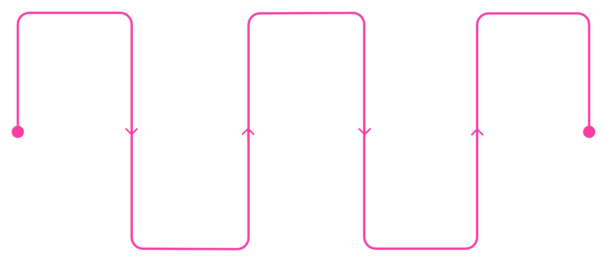
System Architecture
UI Layer
React 19 • TypeScript • Vite • Tailwind • shadcn/ui
User Interface
AI Engines
Results Dashboard
API Layer
React 19, TypeScript, Tailwind
OCR/RAG/LLM, Whisper, YOLOv8
Visualize insights and analytics
FastAPI • Python • Async Processing
AI Layer
OCR/RAG/LLM • Whisper/MediaPipe • YOLOv8/OCR • Analytics
Data Layer
API Layer
MongoDB, ChromaDB, File Storage
FastAPI, Python, Async
Data Layer
MongoDB • File Storage
End-to-end flow: User → Frontend → API → AI Engine → Data → Results → Review

Slide 8
Commercialization Strategy
Target Markets
Pricing Tiers
Universities & Academic Institutions
Online Learning Platforms
Corporate Training Programs
Starter
Professional
Core written & basic analytics
All engines + viva + diagrams
Revenue Streams
SaaS Subscriptions
Consulting & Implementation
API / LMS Integration
Enterprise
LMS integration + custom analytics
Roadmap
MVP → Multi-language → Advanced Analytics → LMS/Enterprise

Slide 9




From Grading Answers to Understanding Learning
Problem
Gap
Manual, subjective, slow assessment
No unified multi-modal approach existed
Solution
Outcome
Written + Viva + Diagram + Analytics engines
Scores + Feedback + Learning Insights
"From grading answers to understanding learning."

Slide 10
Thank You
Questions & Discussion

